Slide 1
Reinforcement Learning Hands-On

Slide 2
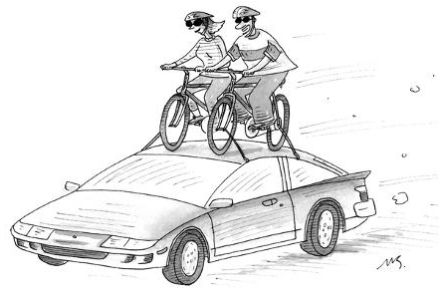
Transfer Learning

Slide 3
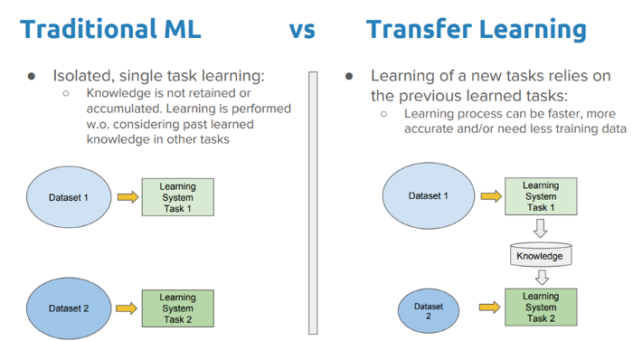
Transfer Learning

Slide 4
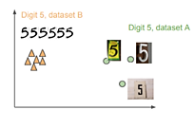

Transfer Learning
What to transfer
Source-specific
Common domain source-target
When to transfer
Negative transfer
How to transfer
Freeze Layers
Fine-tuning Layers
Label space

Slide 5
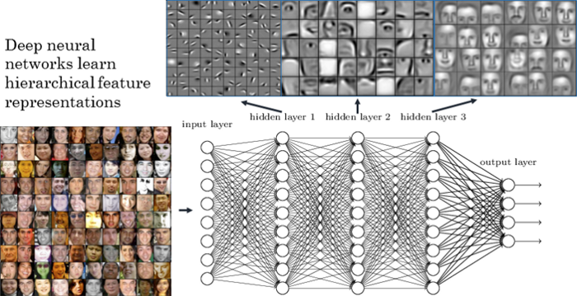
Transfer Learning

Slide 6
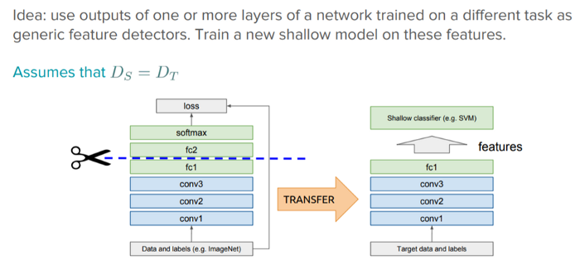
Transfer Learning

Slide 7
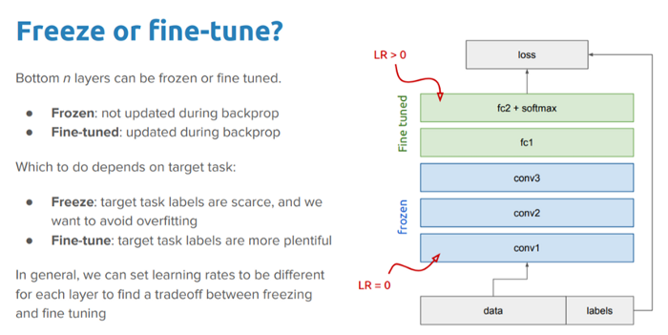
Transfer Learning

Slide 8
RL Introduction

Slide 9
Deep Q-Network

Slide 10
Policy Gradients

Slide 21
Thanks
Contact:
patoalejor@gmail.com

